Slide 1
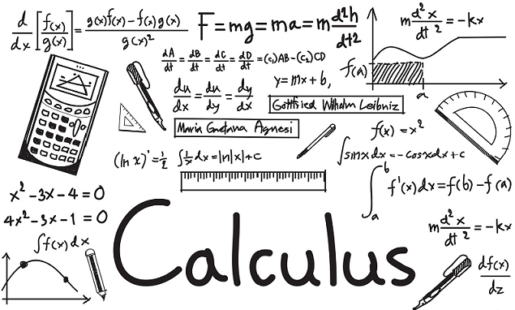
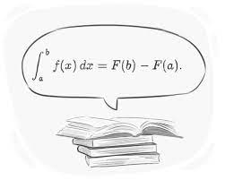
Welcome to Calculus for Middle Schoolers!

Slide 2
On the Agenda…
What is Calculus? Why do we care?
Infinity, Areas, Tangents, Derivatives
Lecture
Worksheet
Q&A

Slide 3
Why do we care about Calculus?

Slide 4
Let’s talk about Infinity…
How many numbers are between 1 and 2?

Slide 5
∞
1 < 1.1 < 2

Slide 6
∞
1 < 1.11 < 2

Slide 7
∞
1 < 1.111 < 2

Slide 8
∞
1 < 1.111… < 2

Slide 9
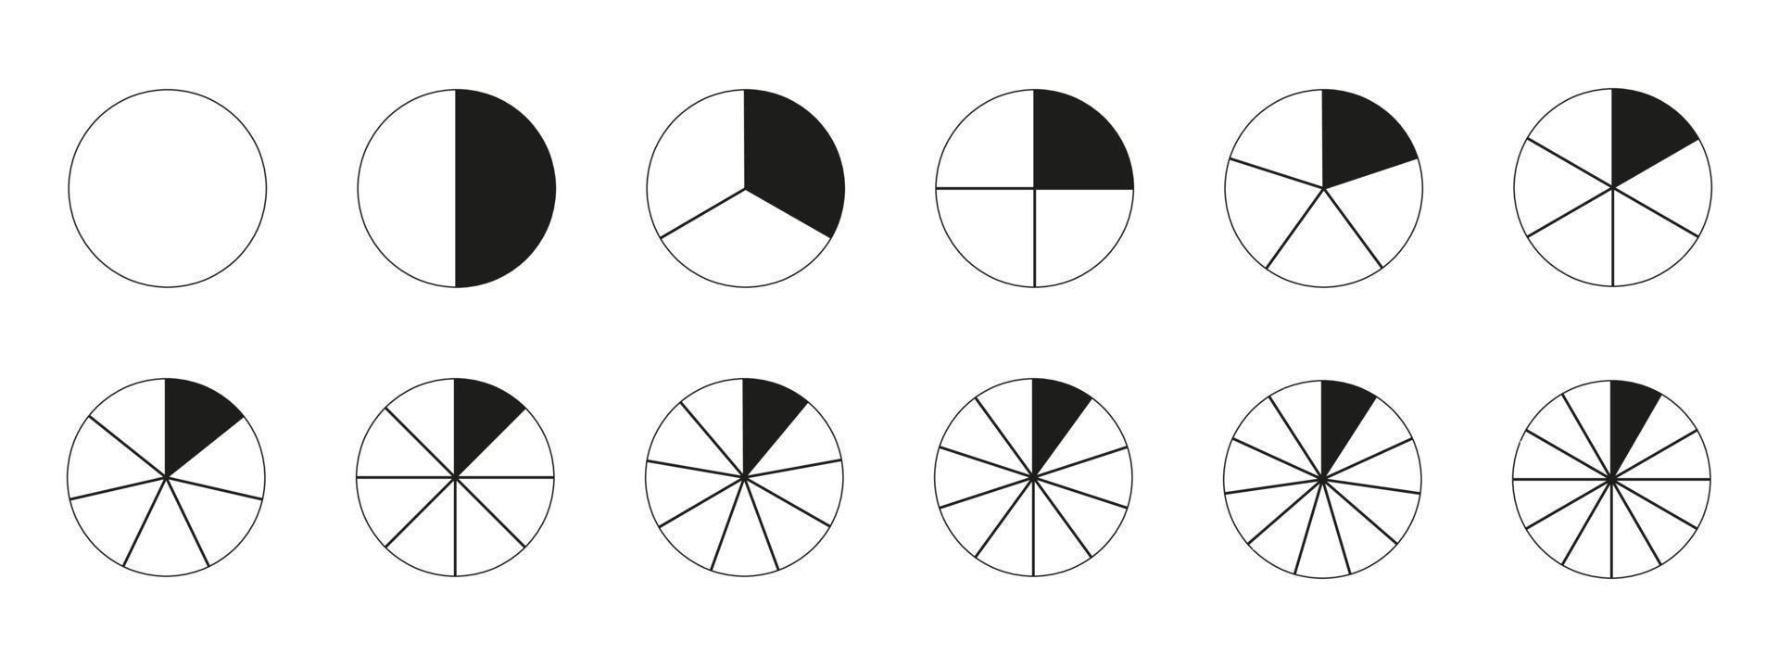
What about 1/∞ ?

Slide 10
So… What is Infinity?
Infinity is NOT a number
Infinity is an idea!
1/∞ ≠ 0, but we can get infinitely close

Slide 11
Area

Slide 12
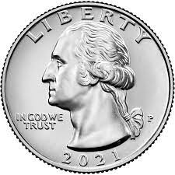
21 Quarters
1 2 3 4 5 6

Slide 13
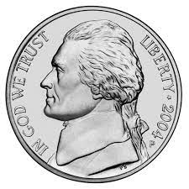
36 Nickels
1 2 3 4 5 6 7 8

Slide 14
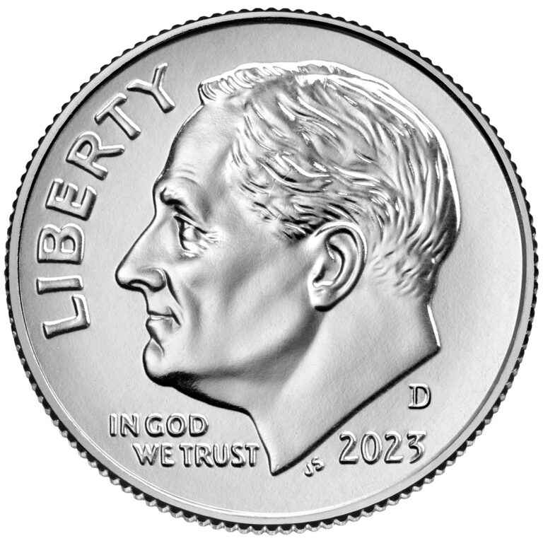
136 Dimes
1 2 3 4 5 6 7 8 9 10 11 12 13 14 15 16

Slide 16
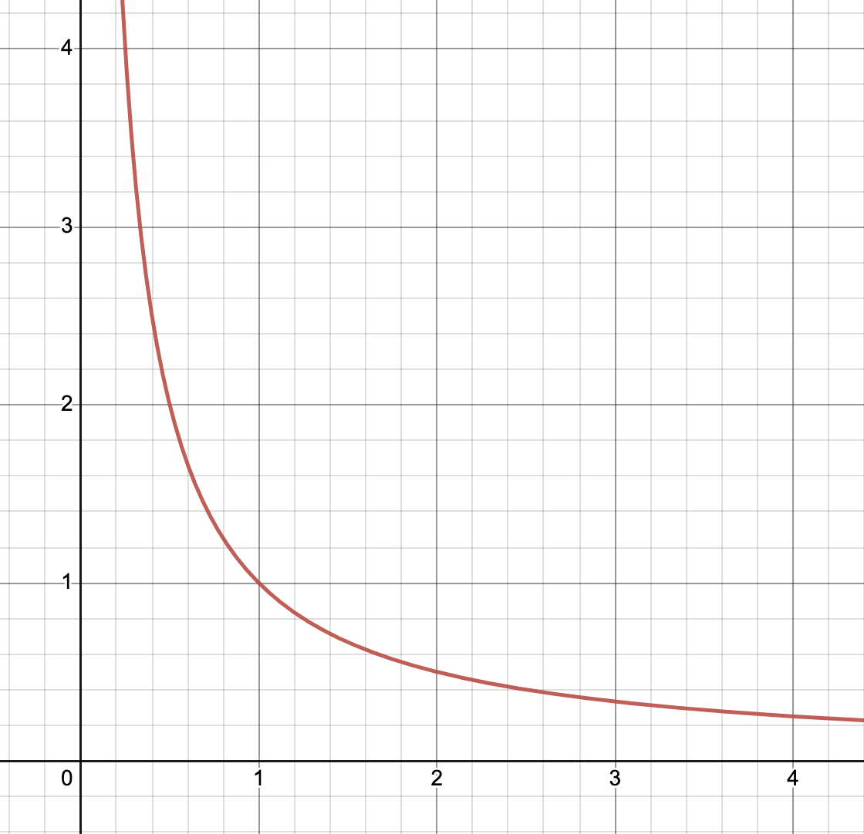
Graphs and Lines
Characteristics?
Observations?
Area??

Slide 17
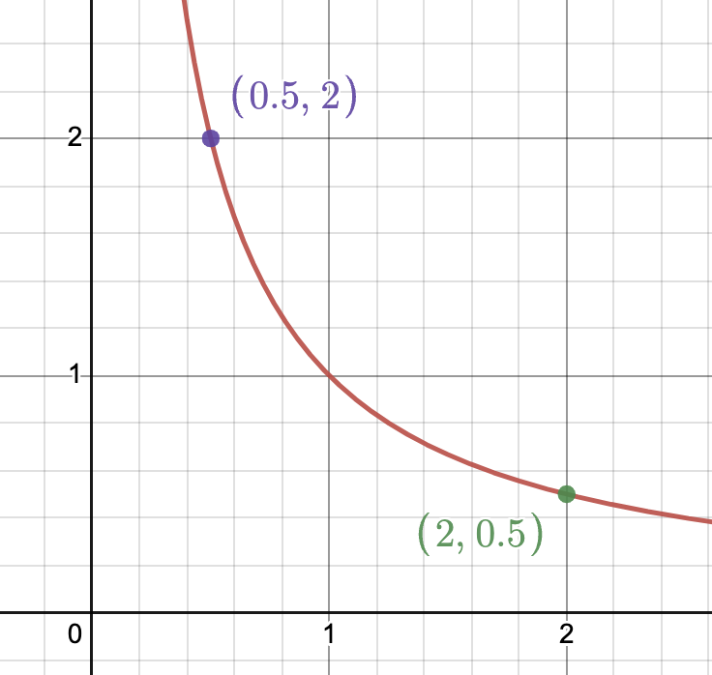

Slide 18
x | 0.5 | 2
y | 2 | 0.5
0.5 – 2
Slope = ———— = –1
2 – 0.5

Slide 19
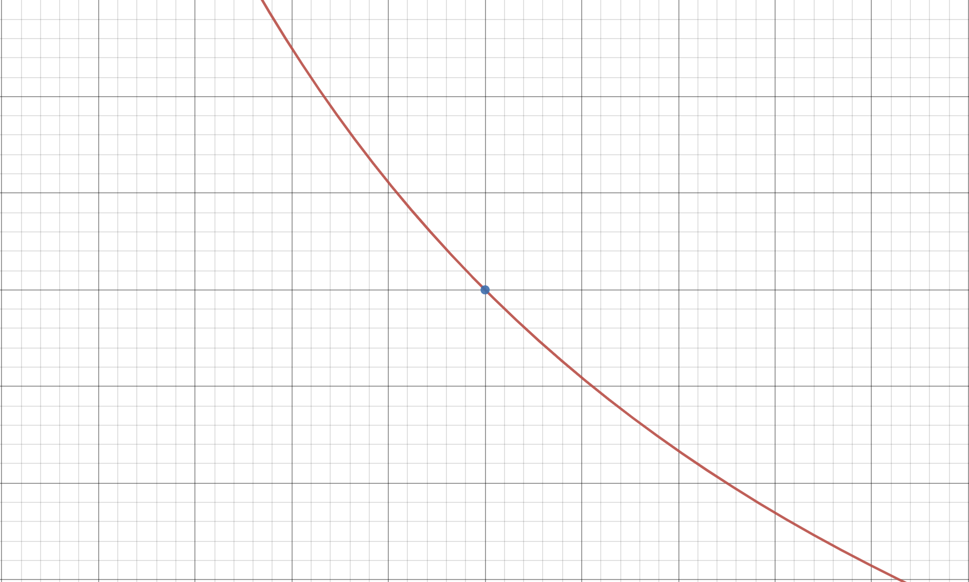

Slide 20
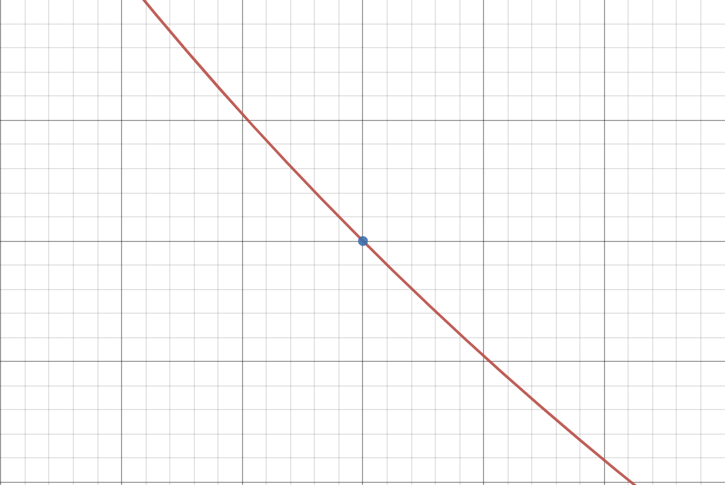

Slide 21
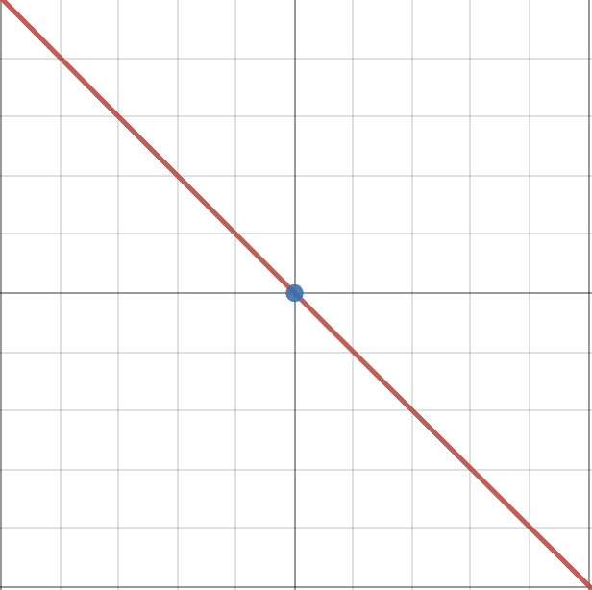

Slide 22
Tangent lines!
Tangent lines help us find the instantaneous (a single moment) slope of a curve.
This is called a derivative
We know rise/run, but not for curves!
Smaller width = more accuracy

Slide 23
Recap
Infinity is NOT a number, but an idea.
1/∞ ≠ 0. We can get infinitely close to 0, but can never touch it.
We can use infinity to estimate areas of shapes, curves, and functions.
Tangent curves can give us the instantaneous slope for any infinitely small point on a graph.

Slide 24
Questions?

